Slide 1
SMArtMart
An OOP assignment by 2021A7PS0050H, 2021A7PS0379H,
2021A7PS0427H, 2021A7PS1345H, 2021A7PS1502H, 2021A7PS2652H

Slide 2
CLASSES USED
Item
User
Customer
Manager
Admin
Cart
Orders

Slide 3
USER
This is an abstract class
It will contain the basic attributes required by all the user of the website
This class contains 2 methods with their implementation
One method is withdraw and the other is resetPassword
Withdraw method will send a delete request to the backend API which deletes an entry from the database containing the user.
Reset Password method will send a patch request to the backend API which modifies the password field in the user database.

Slide 4
User (Abstract)
Attributes:
name
password
address
phone_number
id
Methods:
withdraw
resetPassword

Slide 5
CUSTOMER
This class extends user
It will inherit the basic attributes and methods of the user abstract class
It will also contain an additional attribute which is the account balance which will act like the wallet. Minimum balance is 1000 rupees.
addToCart and addToWallet methods will send POST request to the backend API to add an entry to their respective databases
The delete methods will send a DELETE request to the backend API to delete an entry from their respective databases.

Slide 6
Customer
Attributes:
account_balance(>1000)
Inherited attributes from User
Methods:
Inherited Methods from User
addToCart
deleteFromCart
addToWallet
deleteFromWallet

Slide 7
MANAGER
This class extends user
It will inherit the basic attributes and methods of the user abstract class
It will contain methods to addItem, deleteItem, changeQty, changePrice, changeOffer, setDeliveryDate
addItem and deleteItem work the same way as the previous add and delete methods mentioned
Change and set methods will send a PATCH request to the backend API which will modify the entry with the particular item ID in the Item DB.

Slide 8
Manager
Attributes:
Inherited attributes from User
Methods:
addItem
deleteItem
changeQuantity
changePrice
changeOffer
setDeliveryDate
Inherited Methods from User

Slide 9
ADMIN
This class extends manager
It will inherit the basic attributes and methods of the user abstract class and also of the manager class.
The admin can add or delete accounts of the other users
The admin can also generate reports and print reports of the sales and items

Slide 10
Admin
Attributes:
Inherited attributes from Manager
Methods:
addAccount
deleteAccount
generateReport
Inherited methods from Manager

Slide 11
ITEM
This is the super class for cart and orders
It contains the details that will then be added to the items DB
The get method sends a GET request to the backend API and request the details of the item entry with the given ID in the items DB.
This class will also have an overridden toString function which can be used to print the Item details

Slide 12
Item
Attributes:
item_id
item_name
price
offer
quantity
delivery_date
Methods:
getItem
Overridden toString

Slide 13
CART
This class extends item
It will inherit the basic attributes and methods of the item class
The getCart and clearCart methods will send GET and DELETE requests which will return the Cart item data or delete the entry of that item

Slide 14
Cart
Attributes:
customer_id
Inherited Attributes from Item
Methods:
clearCart
getCart
Inherited Methods from Item

Slide 15
ORDER
This class extends item
It will inherit the basic attributes and methods of the item class
It contains a method to print the orders of a specific user

Slide 16
Order
Attributes:
customer_Id
order_Id
Inherited attributes from Item
Methods:
printOrders
Inherited methods from Item

Slide 17
RELATIONSHIPS BETWEEN THE CLASSES

Slide 18
USER
MANAGER
CUSTOMER
ITEM
ADMIN
ORDERS
CART

Slide 19
Package Structure
com
assignment
supermarket
user
admin
manager
customer
order
cart

Slide 20
FRONTEND AND BACKEND DETAILS
The Frontend is running on React.js and uses the node package manager
The components used are a part of the Material UI Package
This project uses Spring Boot to form the backend API
The type of database being used is a SQL database
The database management system being used is PostgreSQL

Slide 21
Database Structure
users
items
admins
orders
managers
customers
cart

Slide 22
RELATIONSHIPS Between the GUI SCreens

Slide 23
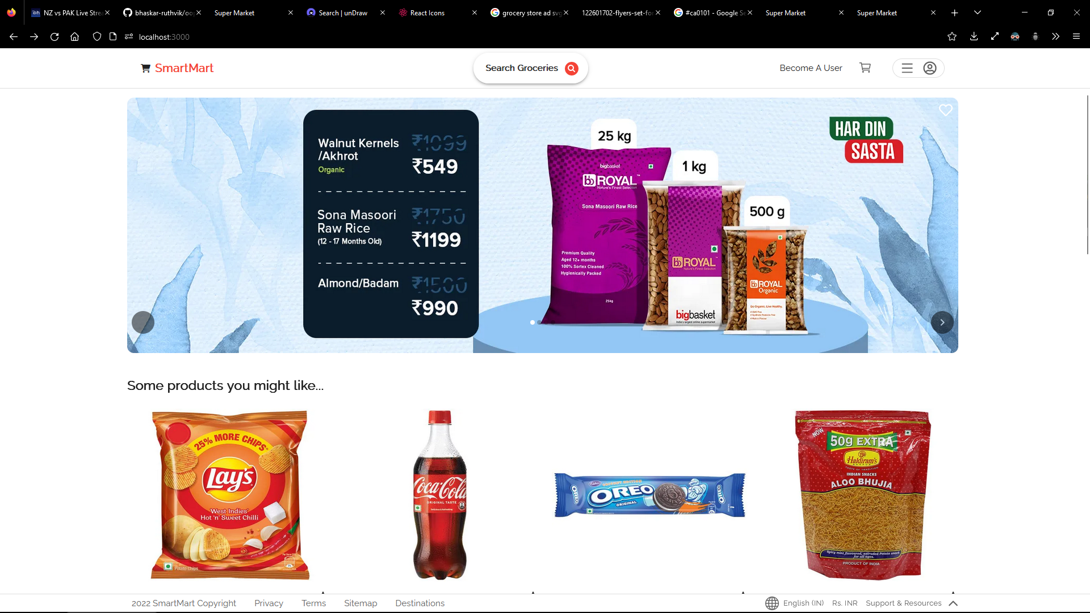
The Homepage of the Website

Slide 24
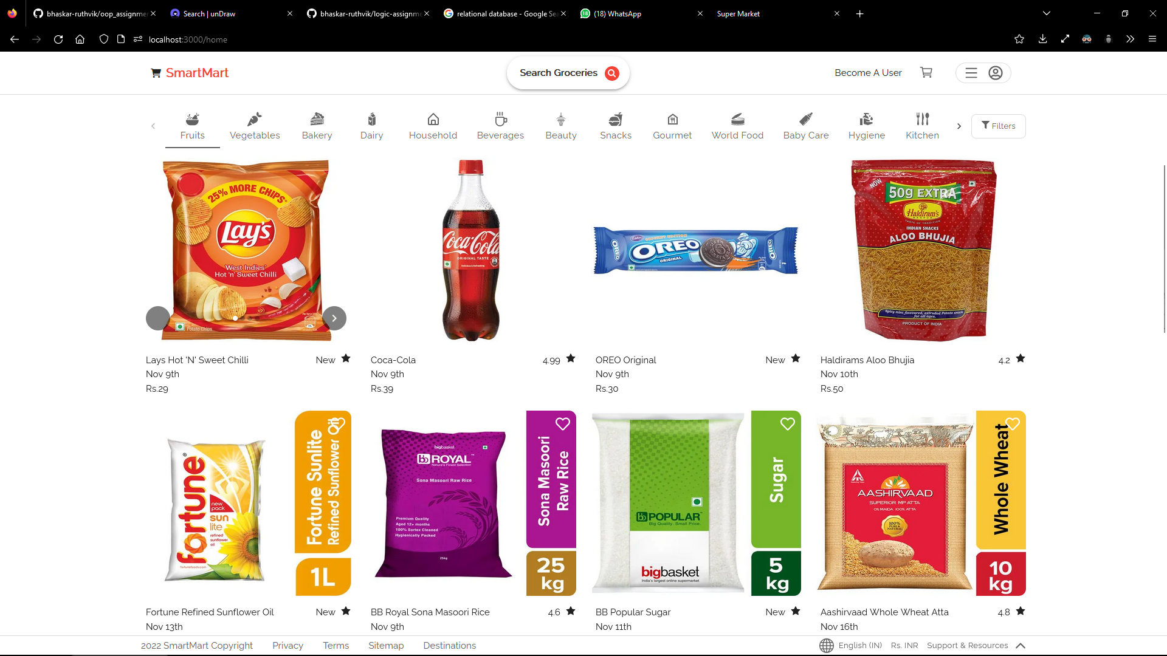
The Categories page of the Website

Slide 25
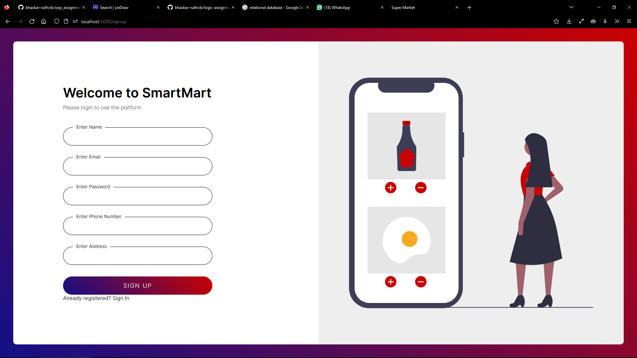
The SignUp page of the Website

Slide 26
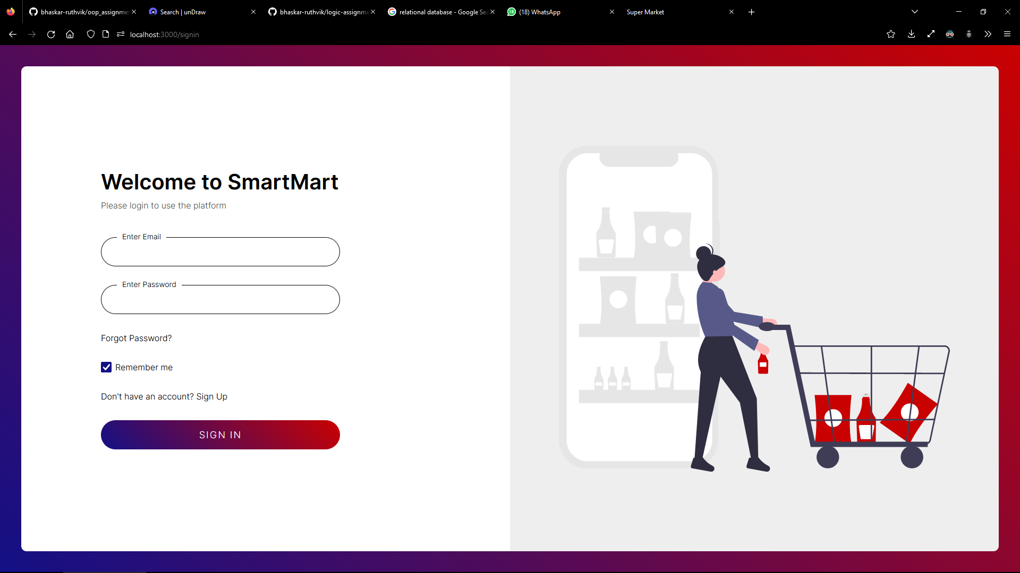
The SignIn page of the Website

Slide 27
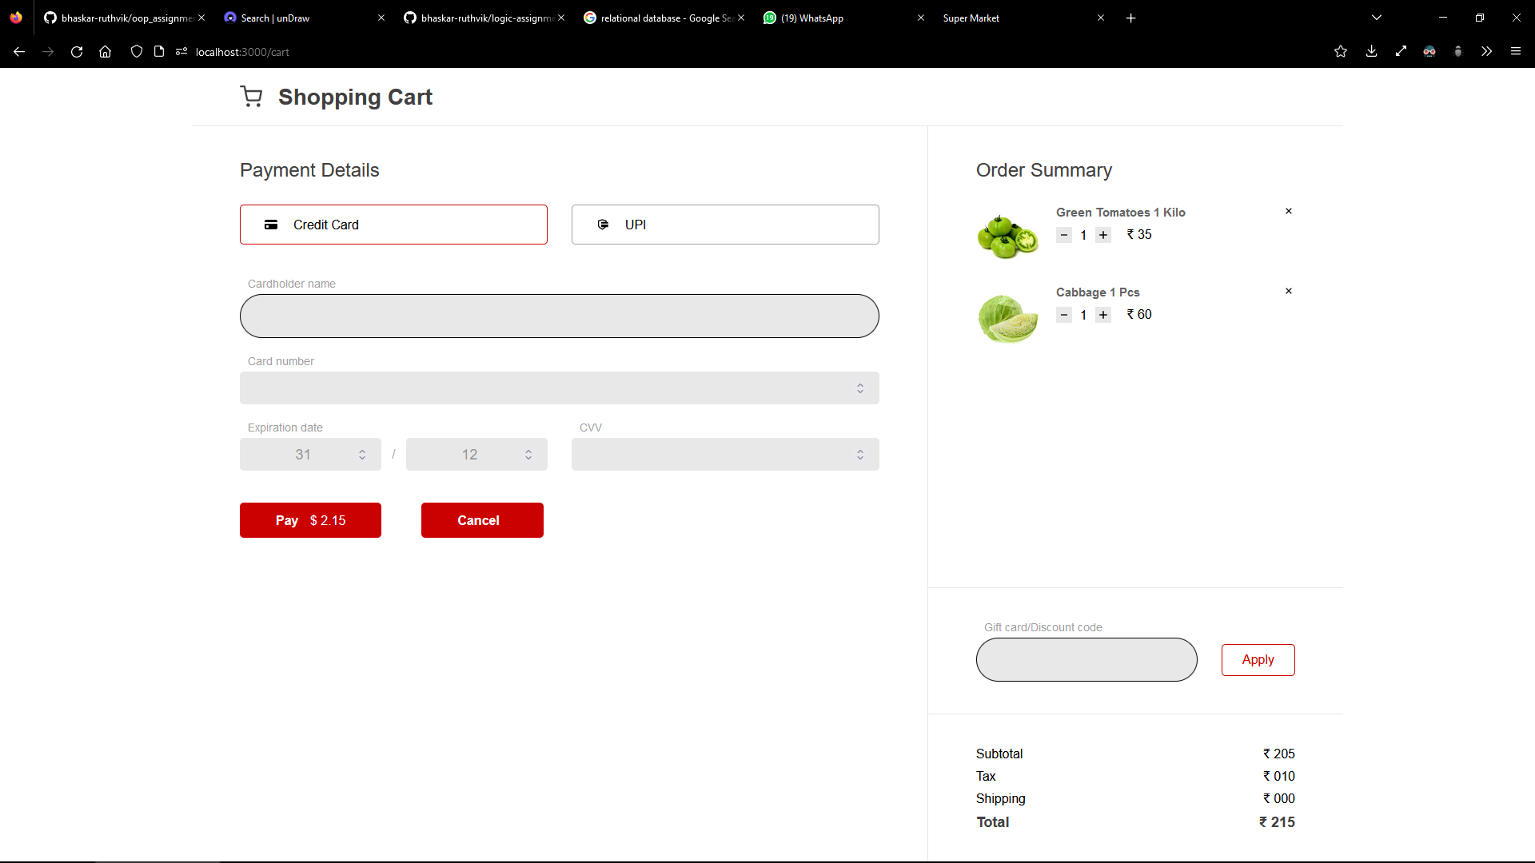
The Cart page of the Website

Slide 28
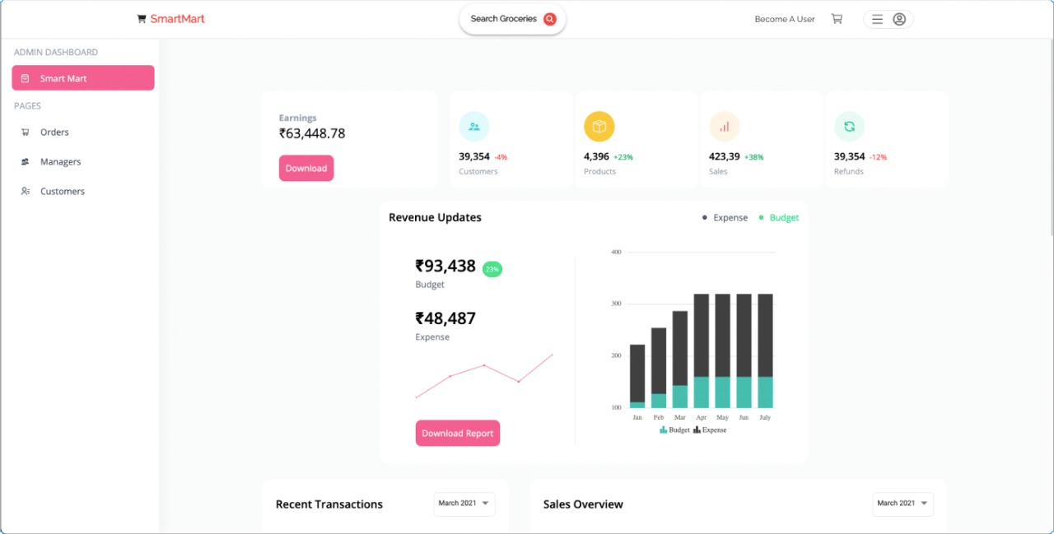
The Admin page of the Website

Slide 29
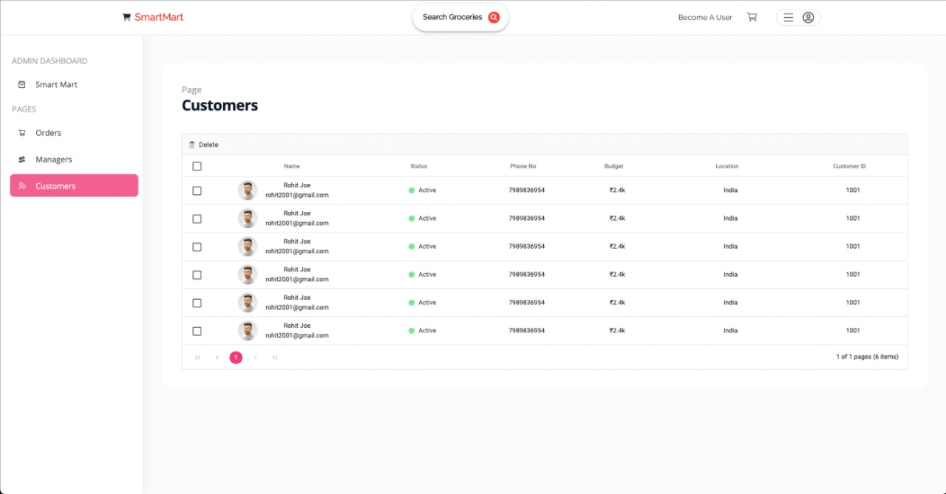
The Admin customer view page of the Website

Slide 30
THANK YOU

